Slide 1

BOOK RESALE PLATFORM

Slide 2
A university has decided to engage a software company for the automation of student result management system of its UG Programme. The following documents are required to be prepared.
Problem Statement
Context Diagram
Data Flow Diagrams
ER Diagrams
Use Case Diagram
User Case Diagram
SRS as per IEEE std.830-1993

Slide 3
Problem Statement
People often finish reading a book only to leave it gathering dust, while others search for that very title at an affordable price but failed so due to lack of organization.
We are trying to bridge that gap by implementing features like:
Search and filter method (i.e. genre, price, popularity).
Book listing ( upload pics, condition ,certification).
Ratings & Reviews ( to find authenticated items).
Book Condition Verification (any wear and tear).

Slide 4
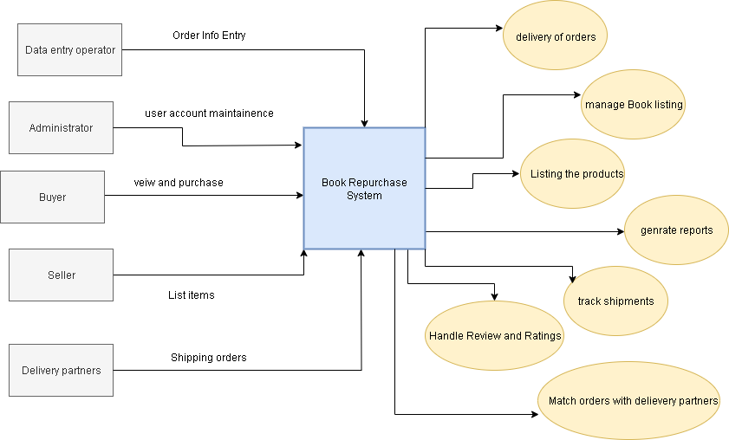
Context level Diagram

Slide 5
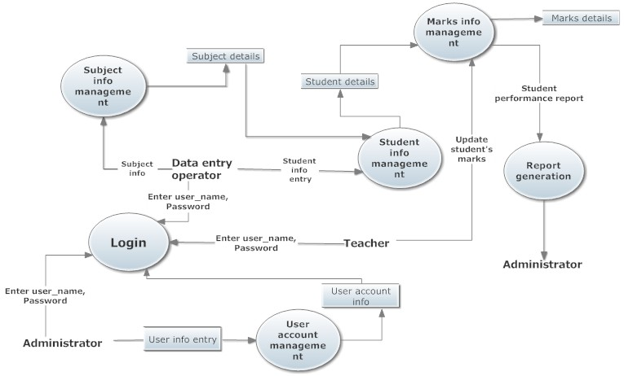
Level-1 DFD

Slide 6
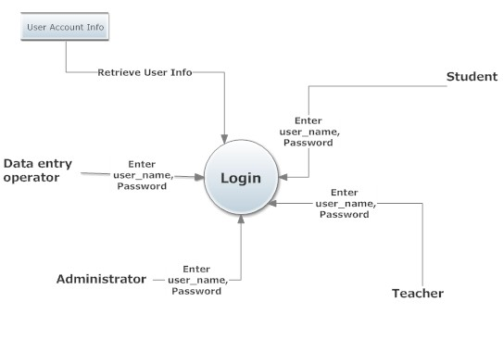
Level-2 DFD of Login

Slide 7
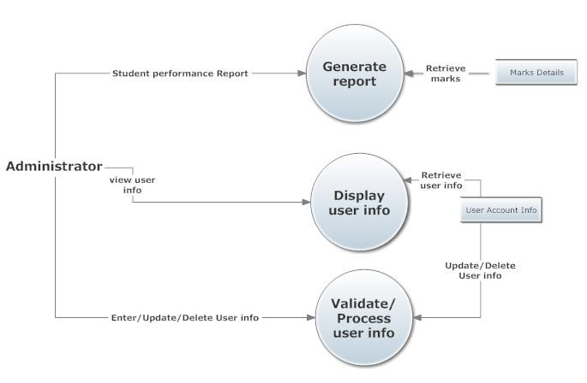
Level-2 DFD of User account maintenance

Slide 8
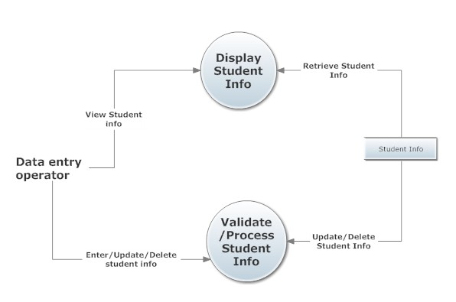
Level-2 DFD of Student information Management

Slide 9
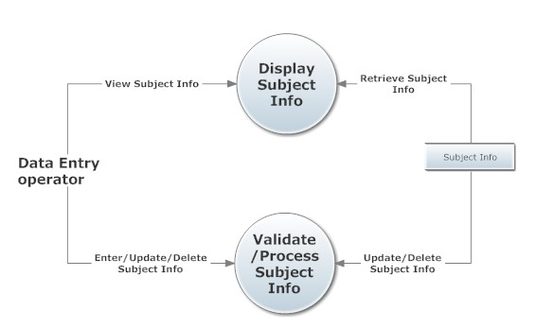
Level-2 DFD of Subject information management

Slide 10
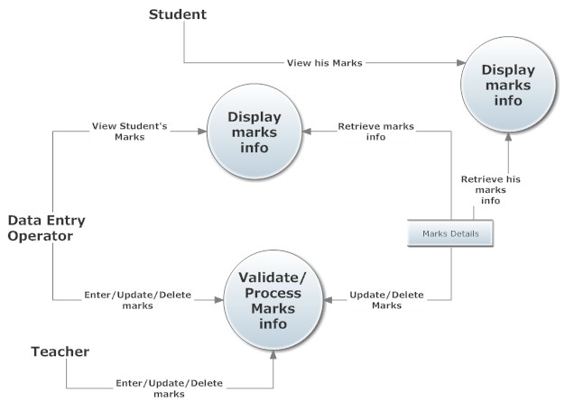
Level-2 DFD of Marks information management

Slide 11

USE CASE DIAGRAM

Slide 12
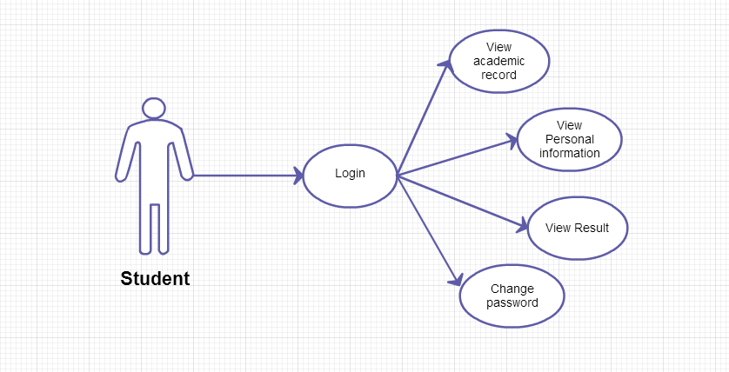


USE CASE DIAGRAM

Slide 13
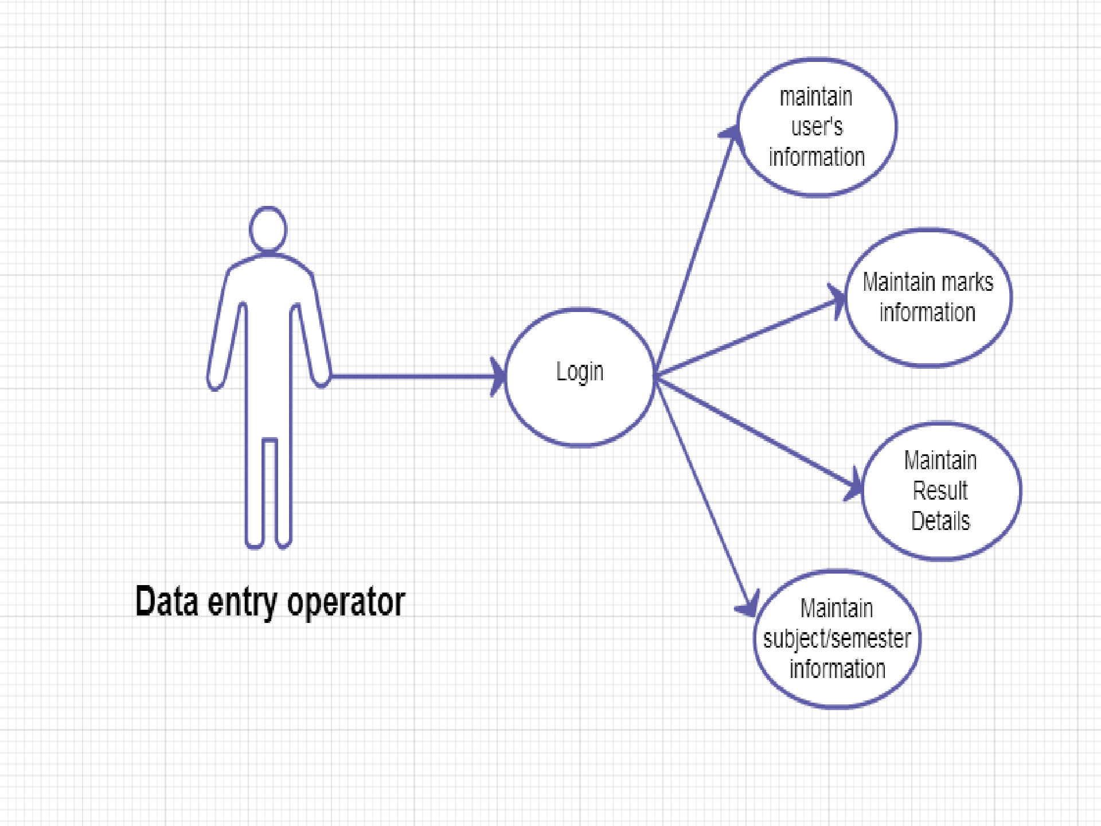
USE CASE DIAGRAM

Slide 14
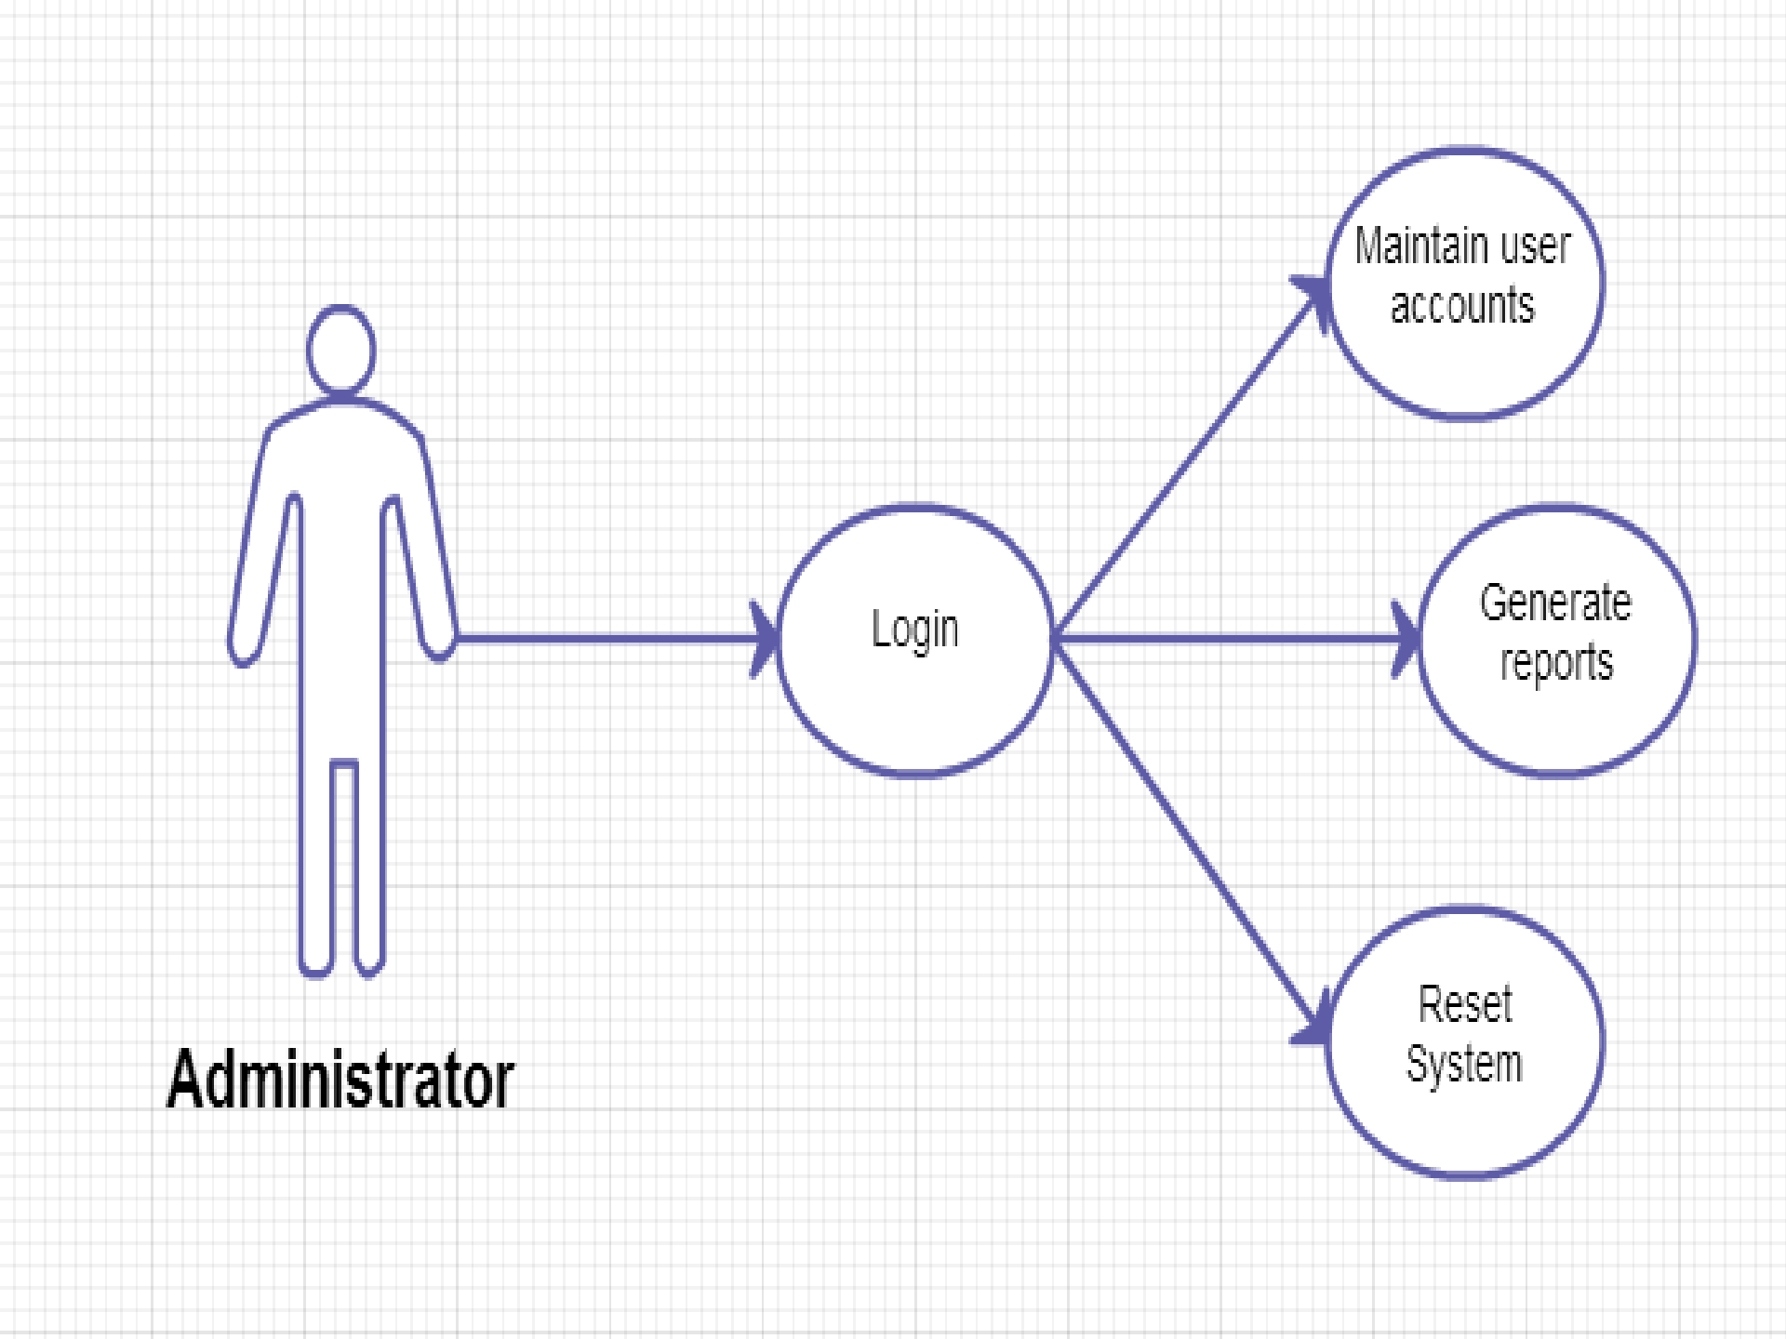
USE CASE DIAGRAM

Slide 15

USER CASE DIAGRAM

Slide 16
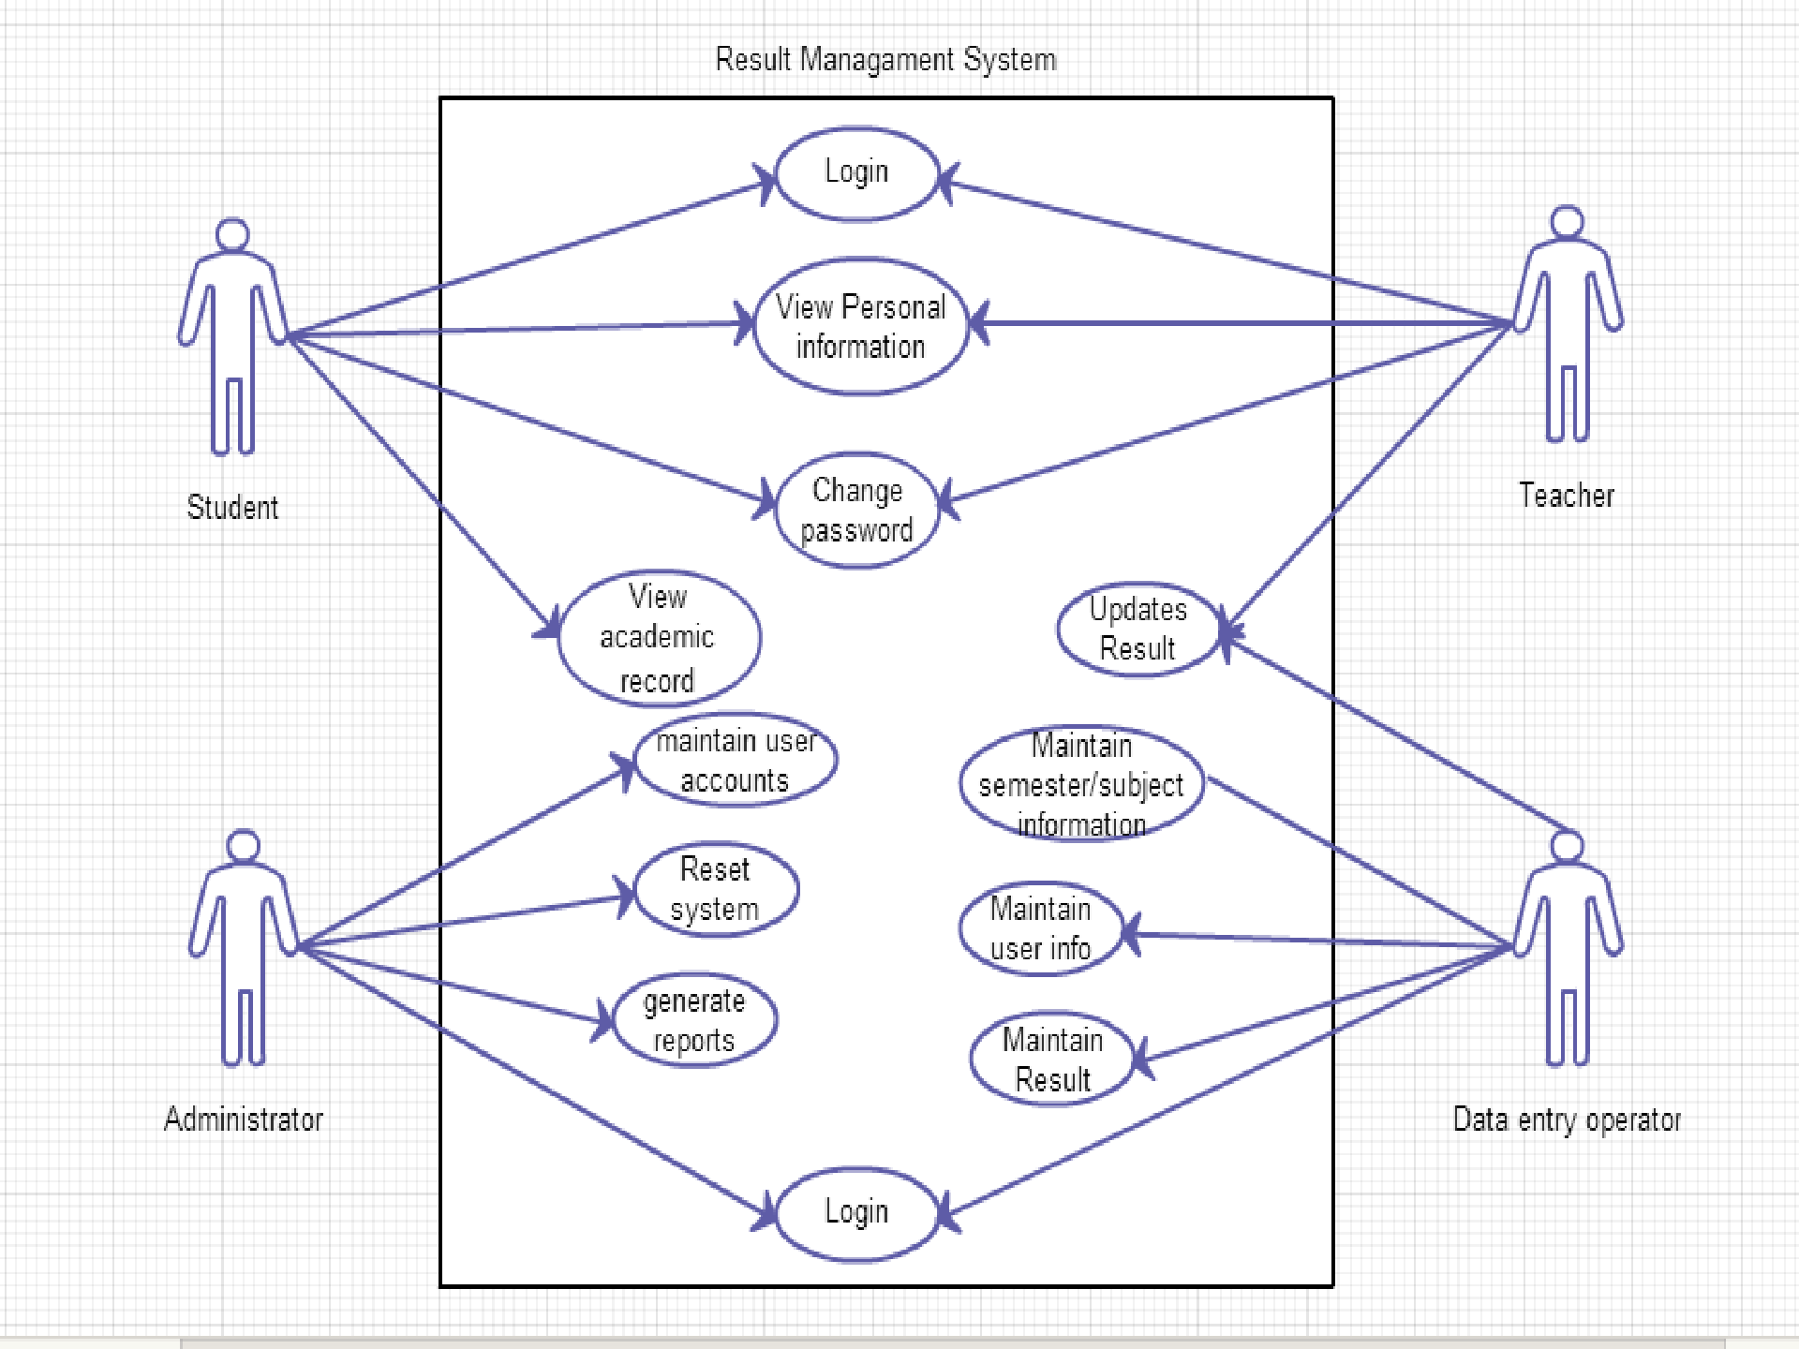

Slide 17
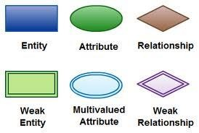
ER DIAGRAM

Slide 18
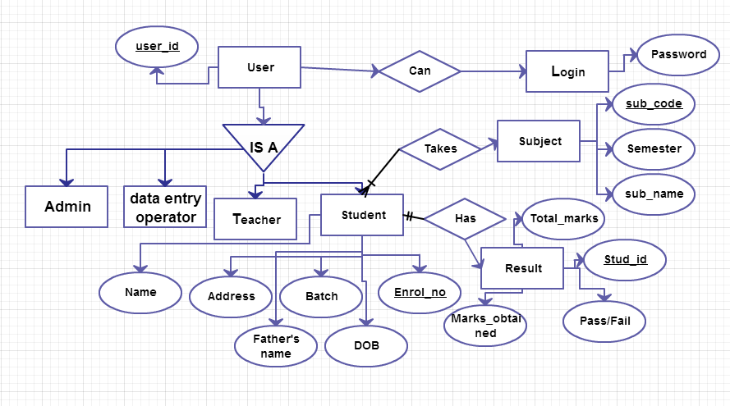
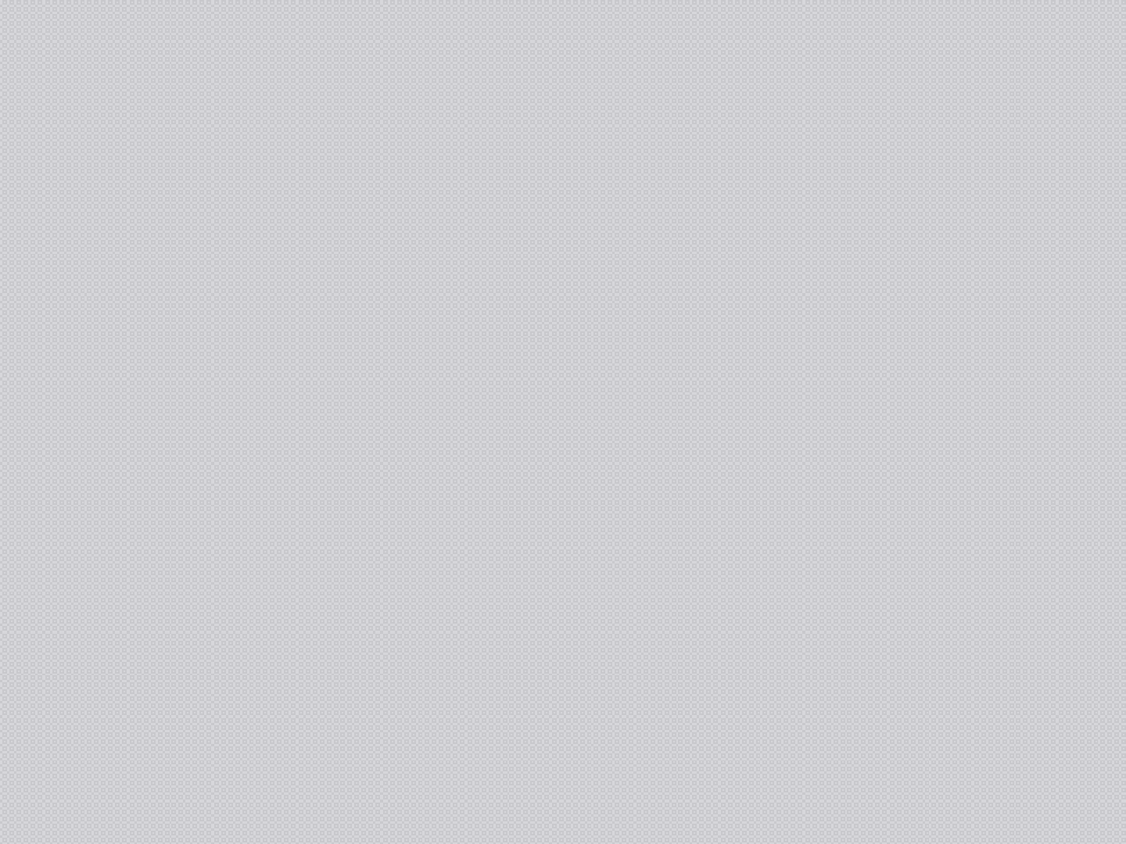

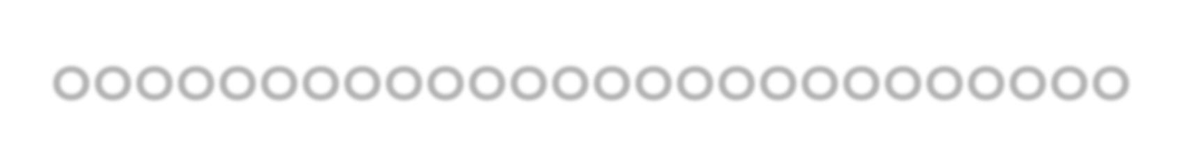
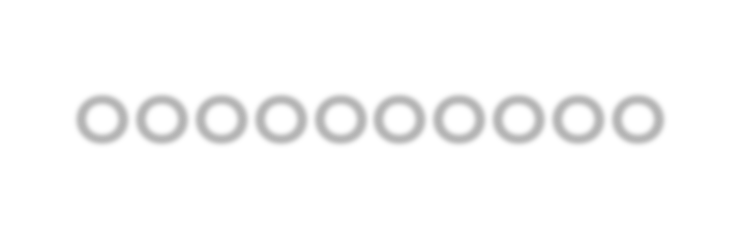



Slide 19

SOFTWARE REQUIREMENT SPECIFICATION

Slide 20
1.INTRODUCTION
This document aims at defining overall software requirement for STUDENT RESULT MANAGEMENT SYSTEM . Efforts have been made to define the requirements exhaustively and accurately. The final product will be having only features/ functionalities mentioned in this document and assumptions for any additional functionality/ feature should not be made by any of the parties involved in developing/testing/implementing /using this product.

Slide 21
1.1 PURPOSE
This specification document describes the capabilities that will be provided by the software application STUDENT RESULT MANAGEMENT SYSTEM .It also states the various constraints by which the system will abide.The intended audience for this document are the development team, testing team and end users of the product.

Slide 22
1.2 SCOPE
The application will manage the information about various students enrolled in this course in different years, the subjects offered during different semesters of the course, the marks obtained by the various students in various subjects in different semesters.
The application will greatly simplify and speed up the result preparation and management process.

Slide 23
2. OVERALL DESCRIPTION
The application will have capability to maintain information about the students enrolled in the course, the subjects offered to students during different semesters , the marks obtained by the students in different subjects in various semesters.The software will also generate summary report regarding student information, semester wise marks list and performance reports .

Slide 24
2.1 USER INTERFACES
Login screen for entering the username, password, type of user(Administrator, Data entry operator, student, teacher)will be provided. Access will be based upon the ole of user.
A screen showing the marks obtained by the student in each subject.

Slide 25
2.2 HARDWARE INTERFACES
Intel p4 processor with minimum 2GHz speed.
RAM: Minimum 1GB
Hard Disk: min 20GB

Slide 26
2.3 SOFTWARE INTERFACES
Visual Studio 2010
Service Pack2 for Windows XP/VISTA
DB Server: SQL SERVER 2008
OS:Window Vista/XP/7

Slide 27
2.4 OPERATIONS
The DBA at client side will be responsible for manually deleting old/non required data. Database backup and recovery will also be handled by the DBA.
The system will provide a RESET SYSTEM function that will delete all existing information from the database.

Slide 28
2.5 PRODUCT FUNCTIONS
Depending upon the user role he/she will be able to access only the specific modules of the system.
Login facility for enabling only authorized access to the system
User (with role Data Entry operator) will be able to modify /add/delete information about different students that are enrolled for the course in different years .

Slide 29
User(with the role of teacher )will be able to add /modify/delete information regarding marks obtained by different students in different semesters
User (with role of administrator) will be able to reset the system leading to deletion of all existing information from the backend database. He will be able to create/modify/delete existing user accounts.

Slide 30
2.6 USER CHARACTERISTICS
1)Users at University will have to implement a security policy to safeguard the marks related information from being modified by unauthorized users(by means of gaining access to backend DB).

Slide 31
2.7 ASSUMPTIONS AND DEPENDENCIES
The number of subjects to be taken by the student in each semester does not change .
The subject types do not change.
The number of semester do not change

Slide 32
3.1EXTERNAL INTERFACES
3.1.1 User Interfaces
The following screens will be provided:
1) Login screen:This will be the first screen that will be displayed. It allows user to access different screens based upon the user role.Various fields available on this screen will be
User id: alphanumeric of length up to 10char.
Password: alphanumeric of length up to 10char
Role:Will have the following values: Administrator, Data entry Operator, student, teacher

Slide 33
3.1EXTERNAL INTERFACES
Subject info Parameter Screen:
This screen will be accessible only to the Administrator. It will allow the user to enter the semester number for which the user wants to access the subject information.
Student info Parameter Screen:
This screen will be accessible only to the Administrator. It will allow the user to enter the Batch Year for which the user wants to access the student information.

Slide 34
4)Student Information Screen: This screen will be accessible only to the Administrator. It will allow the user to modify the information about new/existing student for particular batch year. Various fields available on these screen are: 1. Student Enrollment No: of the format B.E/YYYYwhere YYYY represents the batch year 2. Student Name: only alphabetic letters and length up to 40 chars. 3. Batch Year: of the format YYYY
3.1EXTERNAL INTERFACES

Slide 35
3.1EXTERNAL INTERFACES
Marks Entry Parameter Screen:This screen will be accessible only to the Teacher. It will allow the user to enter the Batch Year, the semester number and the subject for which the user wants to access the marks information.
Marks entry screen: Screen:This screen will be accessible only to the Teacher. It will allow the user to add/modify/delete information about the marks obtained in the selected subject by different students. It includes Student enrollment no, student name, internal marks, external marks, total marks.

Slide 36
3.2 SYSTEM FEATURES
3.2.1 Subject information maintenance
The system will maintain information about various subjects being offered during different semesters of the course.The following information will be maintained for each subject: Subject code, Subject type, Semester.
The system will allow creation , modification , deletion of new, existing subjects and also have the ability to list all the available subjects for a particular semester.

Slide 37
3.2 SYSTEM FEATURES
Validity Checks:
Only user with the data entry operator will be able to access the Subject Information Maintenance module.
No two semester will have the same subject.
The subject code will be unique for each subject .
Subject code, Subject name, semester cannot be blank.

Slide 38
3.3 MARKS INFORMATION MAINTENANCE
The system will maintain information about the marks obtained by various students of different enrollment year in different semesters.The following information would be maintained : Student Enrollment Number, Semester, Subject code, internal marks, External Marks,Total marks.
The system will allow creation/modification/deletion of marks information and also have the ability to list all the available marks information for all students for a particular subject in the given semester.

Slide 39
3.3 MARKS INFORMATION MAINTENANCE
Validity check: Only the user with role of teacher will be authorized to access the Marks Information maintenance module.
Marks cannot be less than 0.
Total marks will be calculated as :Internal Marks in that subject + External Marks in that subject .

Slide 40
3.4 USER ACCOUNT INFORMATION MAINTENANCE
A system will maintain information about various users who will be able to access the system.The following information would be a maintained: User name, user ID, password<Role.
VALIDITY CHECK: Only user with role Administrator will be authorized to access the User Accounts Information Maintenance module. User Name, UserId, Password, Role cannot be left blank

Slide 41
3.5 SOFTWARE SYSTEM ATTRIBUTES
security: the application will be password protected. Users will have to enter correct information to access the application.
Maintainability:The application will be designed in a maintainable manner. It will be easy to incorporate new req in individual module.
Portability:The application will be easily portable

Slide 42
3.6 LOGICAL DB REQUIREMENTS
The following information will be placed in DB:
Subject info: Subject Name, Code, Semester
Student Info: Student Enrolment Number, Student name, enrollment year.
Marks info: Student Enrolment , Semester, internal marks in each subject, external marks in each subject
User Account Info: UserName, User Id, password, role

Slide 43


